Slide 1
K – Nearest Neighbors

Slide 2
Observe the following dataset
Work Hours | Effort | Salary
40 | 7 | 25000
42 | 6 | 25200
38 | 8 | 24800
35 | 7 | 21000
37 | 6 | 21200
45 | 8 | 30000
50 | 7 | 29800
48 | 6 | 30500

Slide 3
Observe the following dataset
Assume that you work 41 hours and your effort level is 6,
what will be your estimated salary?
Work Hours | Effort | Salary
40 | 7 | 25000
42 | 6 | 25200
38 | 8 | 24800
35 | 7 | 21000
37 | 6 | 21200
45 | 8 | 30000
50 | 7 | 29800
48 | 6 | 30500

Slide 4
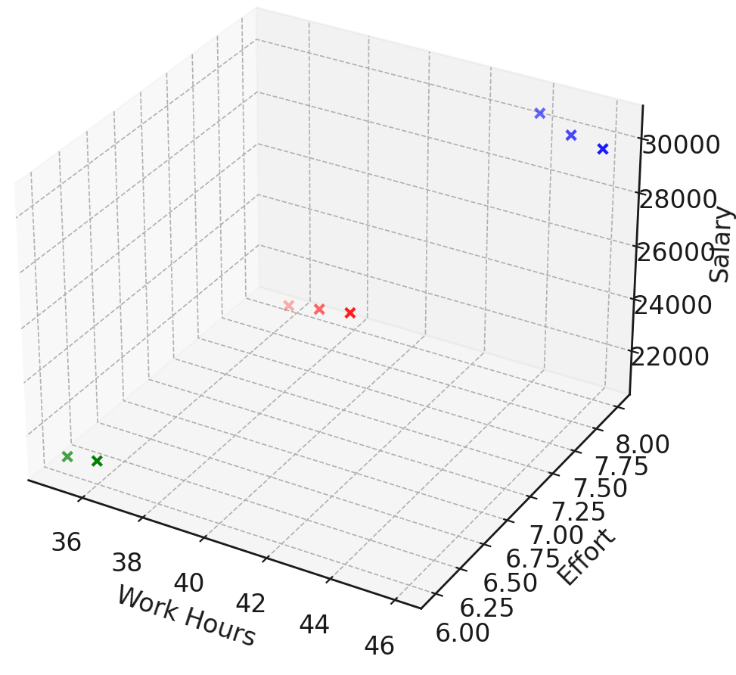
Plot the data

Slide 5
Plot the data

Slide 6
Plot the data
K =3
3 nearest neighbors

Slide 7
Plot the data
K =3
3 nearest neighbors

Slide 8
Plot the data
Calculate the average of the
3 nearest neighbors
K =3
3 nearest neighbors

Slide 9
Plot the data
K =1
1 nearest neighbor

Slide 10
Plot the data
Calculate the average of the
1 nearest neighbors
K =1
1 nearest neighbor

Slide 11
Plot the data
K =4
4 nearest neighbors

Slide 12
Plot the data
K =4
4 nearest neighbors

Slide 13
Plot the data
Calculate the average of the
4 nearest neighbors
K =4
4 nearest neighbors

Slide 14
Plot the data
Calculate the average of the
4 nearest neighbors
K =4
4 nearest neighbors
What we
just did
was
REGRESSION

Slide 15
Classification – using KNN
Another dataset
Square Feet | Number of Windows | Price Category
1000 | 8 | Affordable
1200 | 10 | Affordable
950 | 7 | Affordable
1600 | 12 | Average
1500 | 11 | Average
1700 | 13 | Average
2500 | 18 | Expensive
2400 | 17 | Expensive
2600 | 19 | Expensive

Slide 16
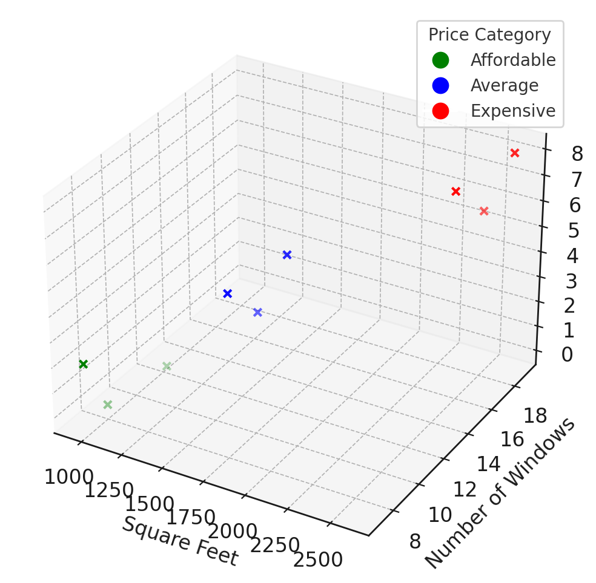
Classification – using KNN
Say K = 3.
How will you determine the type of a house
With 8 windows and 1440 sq feet area?

Slide 17
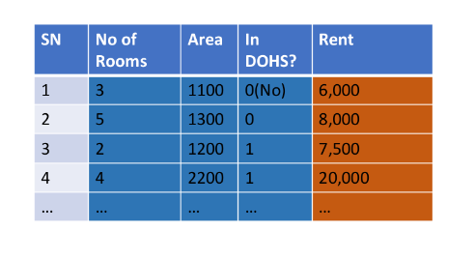
One More Dataset
Can we 3d plot it like before?

Slide 18
Let’s get coding
Try to solve both KNN based regression as well as classification for a small dataset using python
For dealing with numbers – numpy
For plotting – matplotlib
Can we use data from a spreadsheet (excel file/google sheet)?
Pandas library

Slide 19
Thank You

